Slide 1


2021
IBEW
7th District Progress Meeting
October 7, 2021
Kenneth Cooper, International Secretary-Treasurer
Brian Threadgold, Senior Executive Assistant to the International Secretary-Treasurer

Slide 2
Per Capita & PBF
Top 5 Items causing issues in Per Capita and Digital Application Process.
Top 5 Items causing issues in Pension and general PBF Information.

Slide 3
Per Capita
#1 Issue
Missing forms required in order to process transactions in Per Capita.
- Many locals submit per capita reports with missing required forms or dues deduction reports.
- Any transaction requiring an IBEW form in order to process the transaction will be denied if the form isn’t received.
- This issue also can cause confusion with balances as well as missing member information or transactions in a local journal.

Slide 4
#1 Solution
Local Unions should make it a habit to only complete a transaction in their monthly per capita report if they know they have any and all required forms that will be needed in order for the transaction to be completed.
i.e. – Honorary Withdrawal
Participating Withdrawal
Military Withdrawal
Travel Cards, etc.

Slide 5
#2 Issue
Mailing in Local Union Per Capita Forms
Currently we still have Local Unions that submit their required forms by mail.
  Waiting on forms greatly slows down the efficiency of processing a Local’s per capita report.
  Any transaction that requires an IBEW form in order to process the transaction will be denied if the form isn’t received at the time of processing the report.
  Some Local’s don’t save a copy of the forms and if they are lost in the mail the Local will need to have a new form completed.

Slide 6
#2 - Solution
Locals should use the Local Connections upload tool through their per capita reporting system to upload all forms, or they can email the forms to percapita@ibew.org.
The Locals should also save a copy for their records as well.

Slide 7
#3 Issue
Local Unions not reading their Per Capita correction reports and addressing corrections needed.
- Currently Locals that don’t read their correction reports in their completed per capita reports. These reports explain any issues that were found in the per capita report as well as instructions on how to fix this issue.
- If a transaction was unable to be processed for the Local it will explain the reasoning in the correction report.
- The correction report will also explain any fees, charges or credits applied to the Local’s account.
- Locals lose track of their balances or membership records when they don’t read the correction report causing continued issues.

Slide 8
# 3 Solution
Take the time to review your monthly correction report. This will be extremely helpful for cleaning up membership records entering into a Convention year or in the event of a Local Union election.
- After the 3rd notice to a Local Union on a correction report, IR David Fenton will reach out to your servicing representative to notify them of the issue and work on a solution.

Slide 9
#4 Issue
Local Unions using LPX Per Capita Reporting System software when they could be utilizing eJournal.
- Currently smaller non-construction Local Unions using LPX for basic Per Capita reporting that struggle with the complexity of LPX and would benefit from a less complicated reporting system.
- Locals that struggle with LPX that only do basic per capita reporting are less likely to be submitting their per capita reports on time and accurately.

Slide 10
#4 Solution
Converting smaller non-construction Local Unions that perform basic Per Capita reporting to eJournal is easy and quick. Contact IR David Fenton;
David_Fenton@ibew.org
David can assist in getting locals set up and running with eJournal which makes things much simpler for Locals that do not use the functionality of LPX Software.

Slide 11
# 5 Issue
Members that reach retirement eligibility within the Local Unions plans and subsequently drop membership due to failure to pay dues.
- In some instances Local Union pension funds have the ability to retire at the age of 55. Members achieve retirement age and stop paying dues only to find out they’ve lost out not only on their respective PBF Pension Benefits which include the Death Benefit as well.

Slide 12
# 5 Solution
Communicate with your membership specifically about the provisions required by Article XI, of the IBEW Constitution, related to eligibility and membership requirements.

Slide 13

IBEW Digital Membership Application
Completed in Collaboration with;
- IBEW Membership Development
- IBEW Information Technology Department
- IBEW Per Capita Department

Slide 14
Logistics of IBEW Membership Application
Potential new member applies
Application is completed and submitted to Local Union by potential member.
Local Union
New member is approved for membership and is sworn in to local.
Local assigns member number and completes application, generates NM transaction in per capita report and submits report and application to IO.
Per Capita Department
Receives and processes local’s report with new member transaction
Record is created and application is stored in member’s and local’s file.

Slide 15
Current issues with Membership Applications
Currently approximately 15% of new member transactions are denied for initial processing by the Per Capita Department due to the following reasons.
- Local didn’t provide the members application with the Local Union Per Capita report and the new member transaction.
- Applications are incomplete or missing required information in order to be processed.
* The missing information is legally required in order to properly initiate a new member into membership with the IBEW.

Slide 16
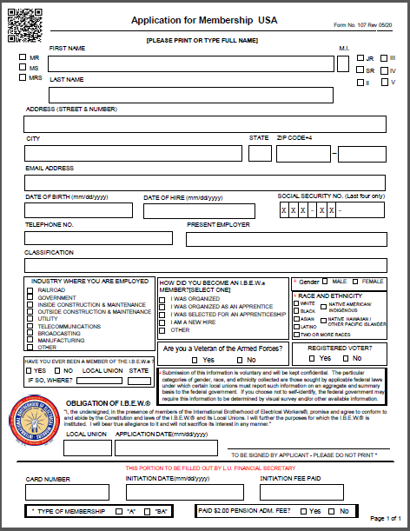
New Digital Application Form
Along with creating the new digital application, the current IBEW 107 Form PDF version has been revised to match the digital format

Slide 17
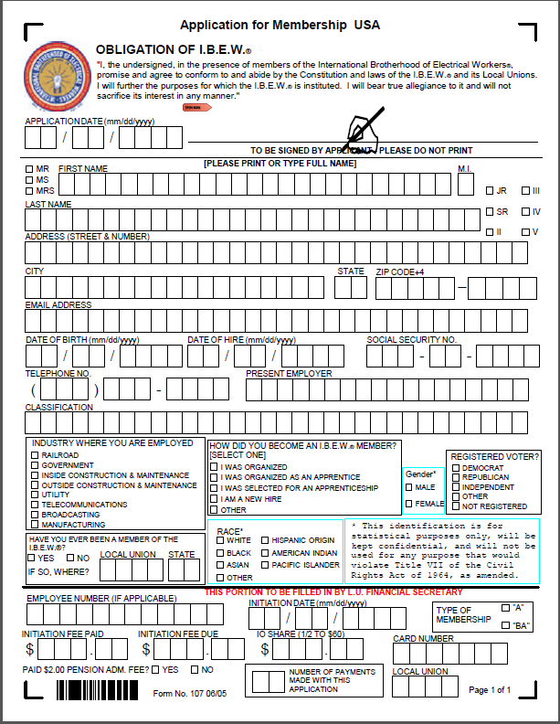
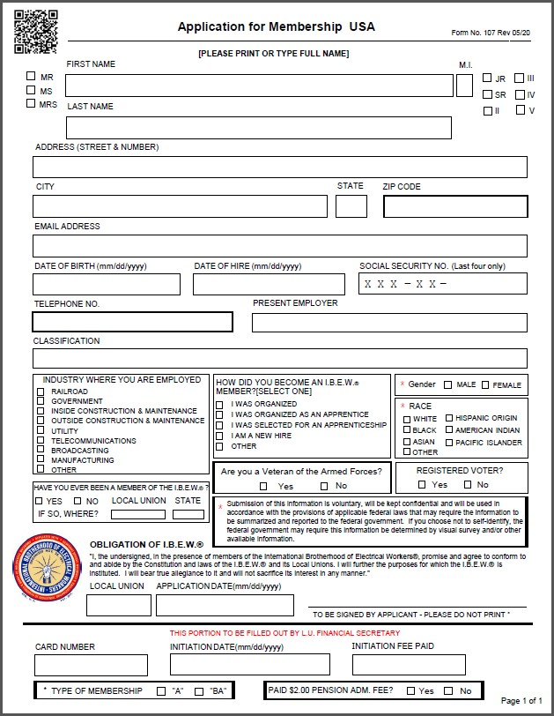
Old Application vs. New Application
Differences
Signature and Application Date have been moved to the bottom of the form.
Addition of Veteran of Armed Forces question
Revised Registered Voter question.
Only the last 4 numbers of the SSN required.

Slide 18
So why change to a Digital Application??
Efficiency & Accuracy
Easier accessibility to potential new members
Faster disbursement to the new members, local unions and International Office
Legible – easier to read
Required information must be provided – no missing information
Trackable – ability to contact member with questions.

Slide 19
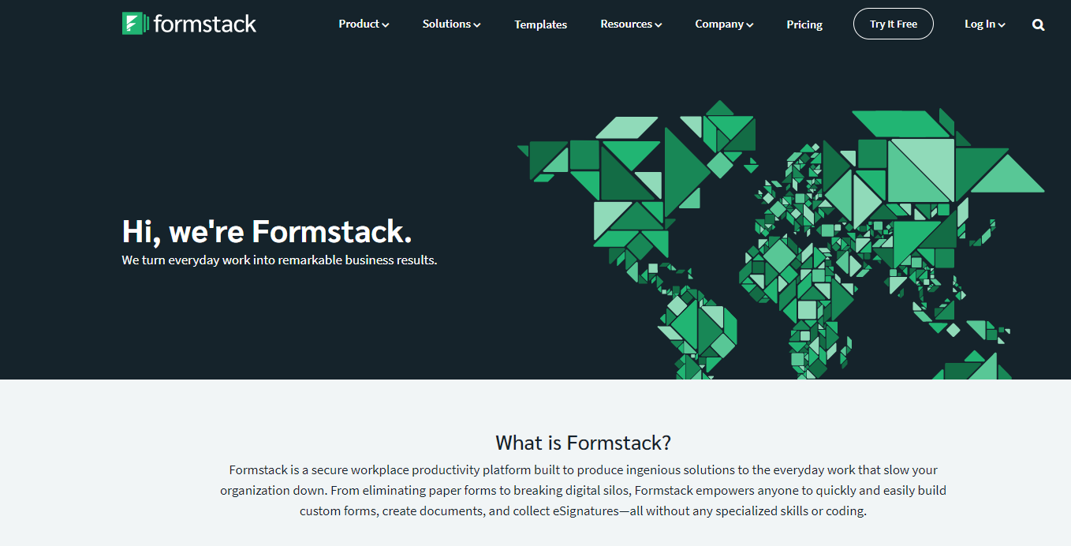
The app platform was created through Formstack, vetted by the IT Department and approved by IP Stephenson

Slide 20
How do Local Unions utilize the new app??
- Your Local Union can request to use the new application by contacting the IBEW Per Capita Department at:
Percapita@ibew.org
ibewformstackforms@ibew.org
- Your Local Union can reach out to your International Servicing Representative to help facilitate the setup.
- Local Union Requirements;
The Local Union must provide a viable email address to the Local Union and not to an individual person.
The Local Union will need to create a Formstack Profile account with a link provided.

Slide 21
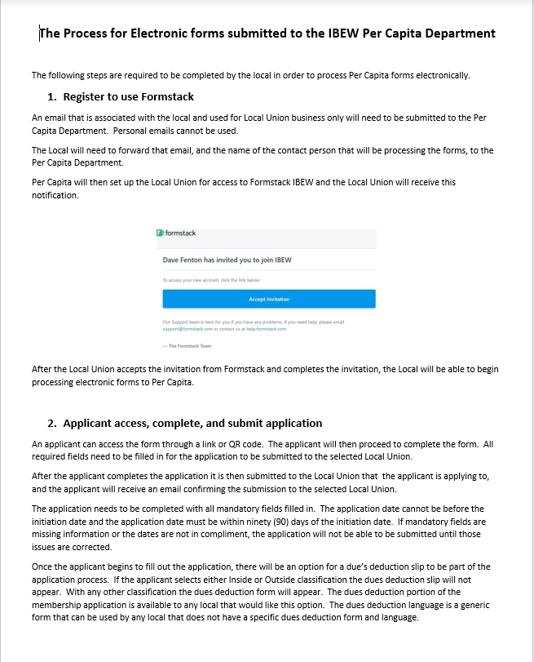
Your Local will receive a Setup Email from Per Capita
The setup email will include the following information;
- Digital Membership Application instruction guide with QR code and weblink to appropriate applications for your local.
- A link and instructions to setup a user profile in Formstack.

Slide 22
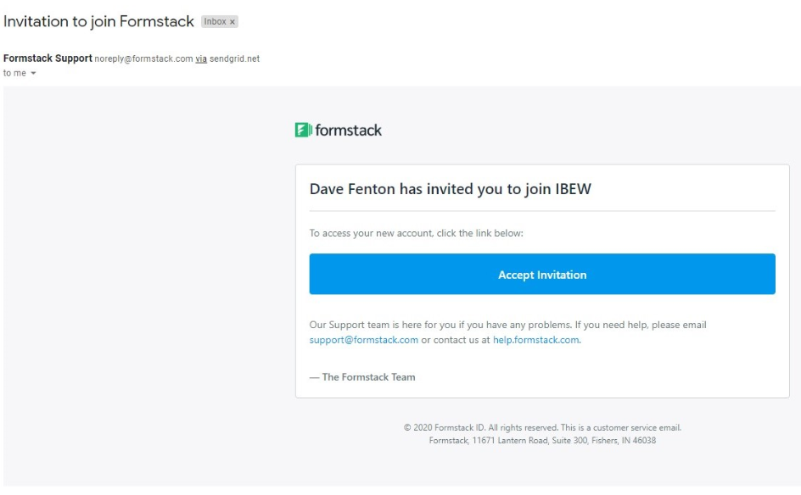
The Local will need to create a profile in Formstack
The profile is a one-time setup that enables Formstack to recognize an added user (Local.)
Locals will use this login to access Formstack to complete new applications when submission notification emails are received.

Slide 23
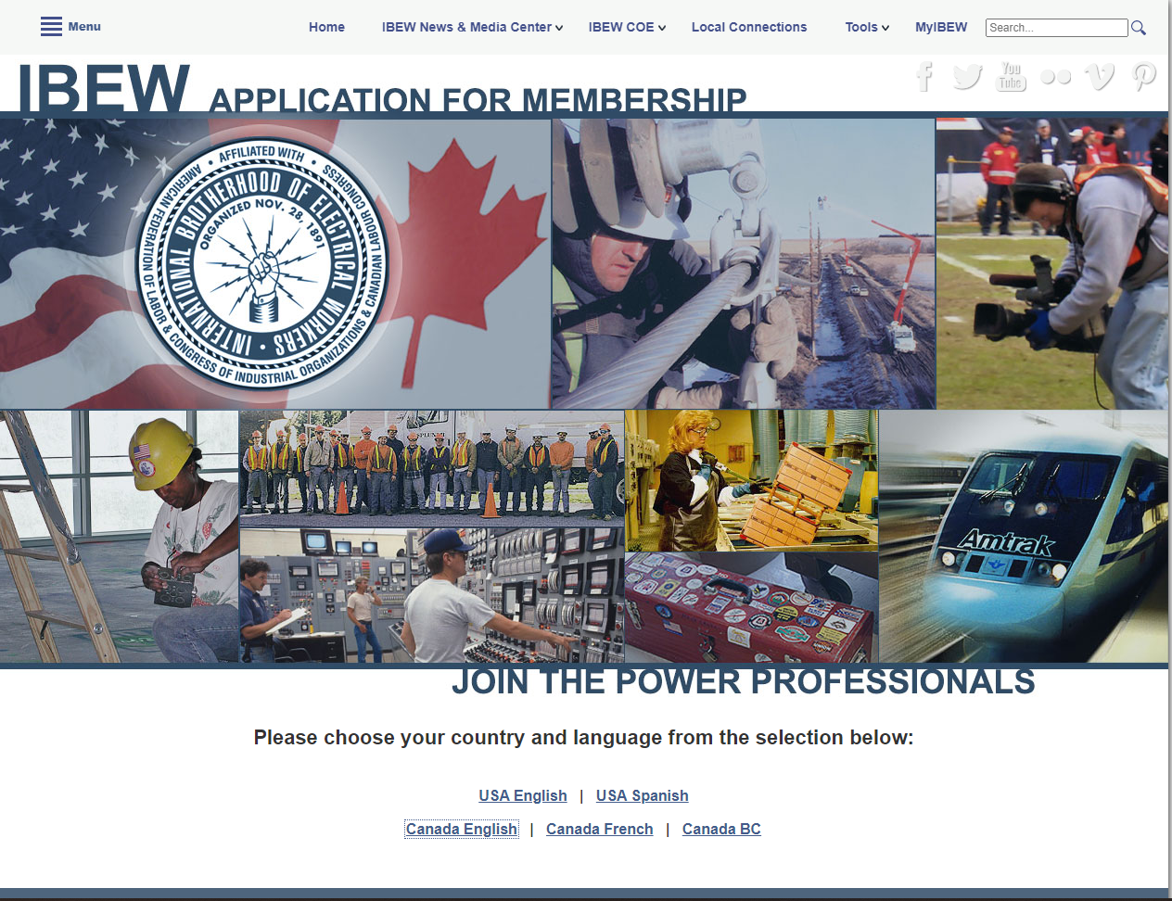
IBEW Application website
WWW.IBEW.ORG/MEMBERSHIP_APPLICATION

Slide 24
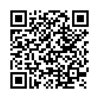
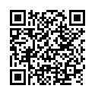
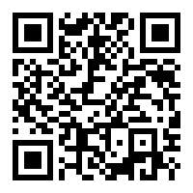
QR Codes are on all forms of application and are provided in the Instruction Guide.
USA FORM
USA SPANISH FORM
IBEW Application Website

Slide 25
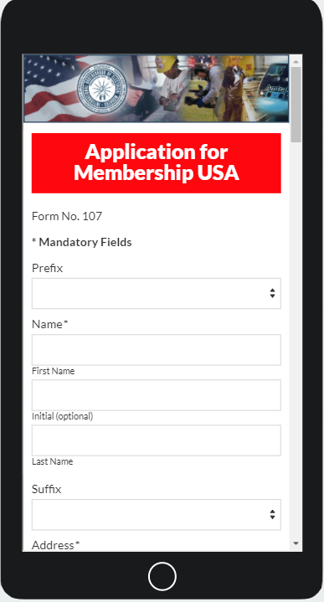
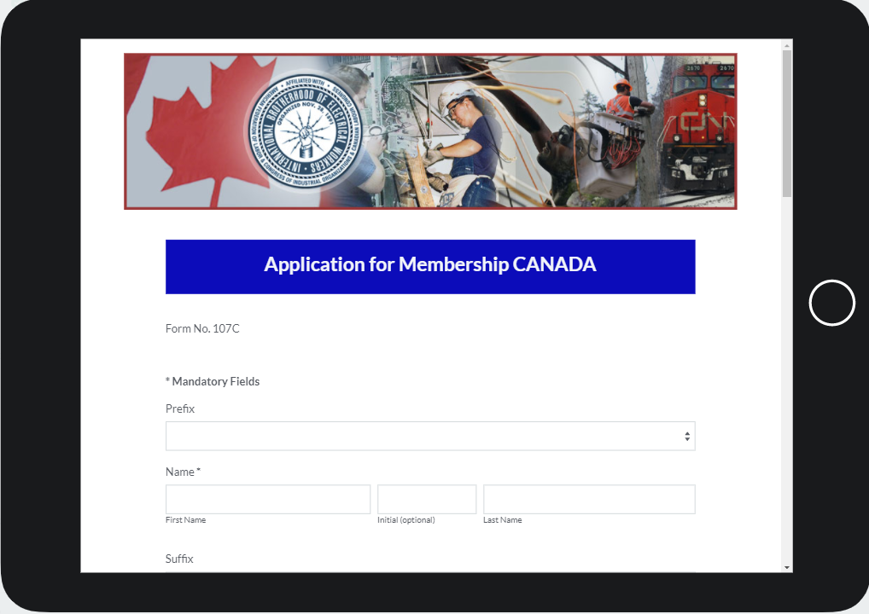


The Digital Membership Application can be accessed by Using:
Smart Phone
Tablet
PC
This Photo by Unknown Author is licensed under CC BY-NC-ND

Slide 26
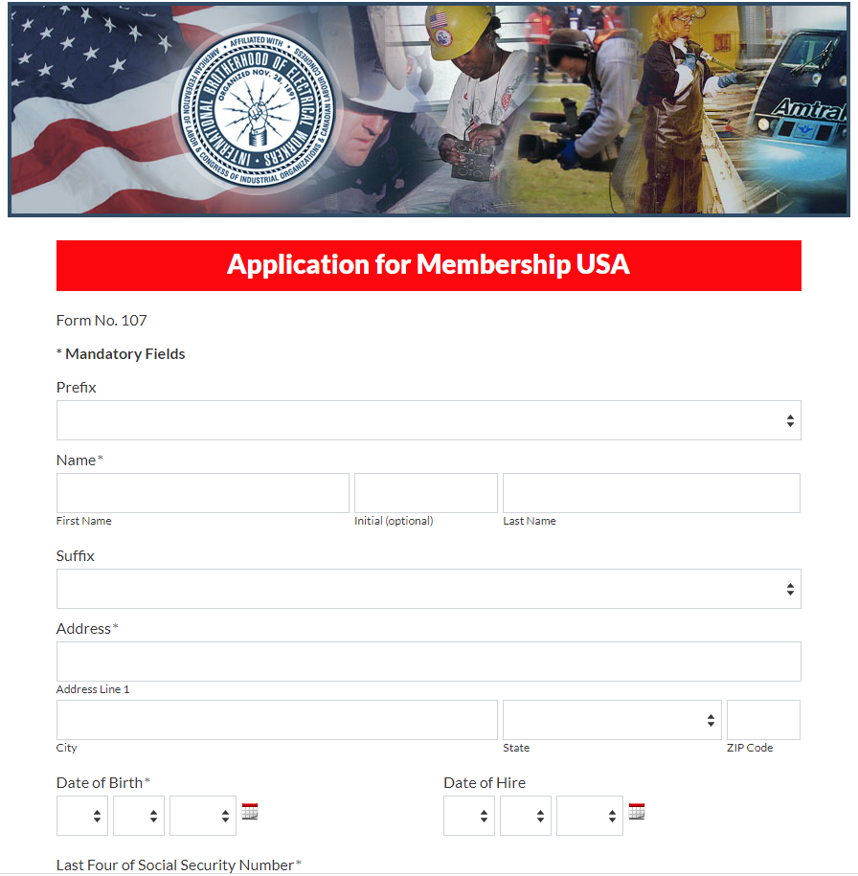
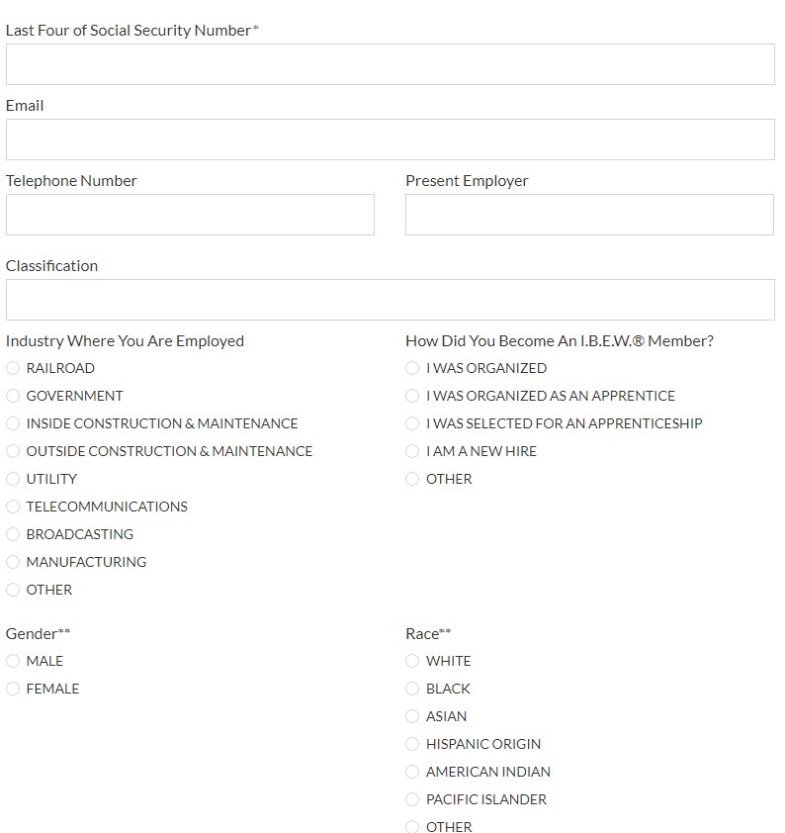
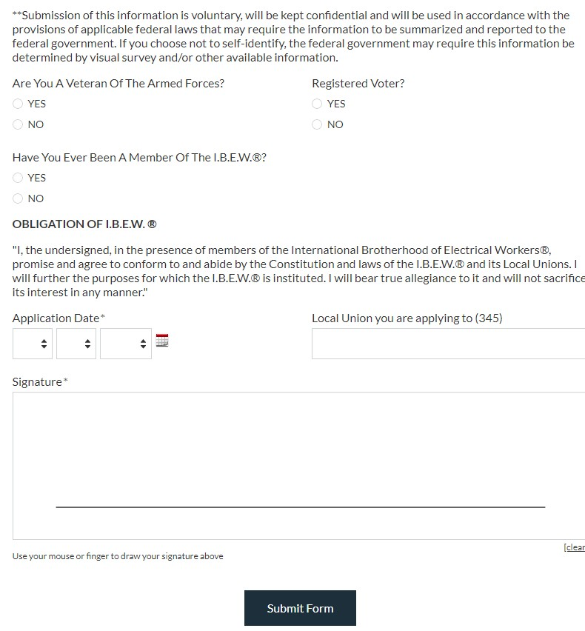
APPLICATION USING DIGITAL FORM

Slide 27
New Member Required Information
Name
Address
Date of Birth
Last 4 digits of SSN or SIN
Local Union Applying to
Application Date
Signature
Email Address
Digital Form has Required Mandatory Fields that need to be Completed Before it can be Submitted.

Slide 28
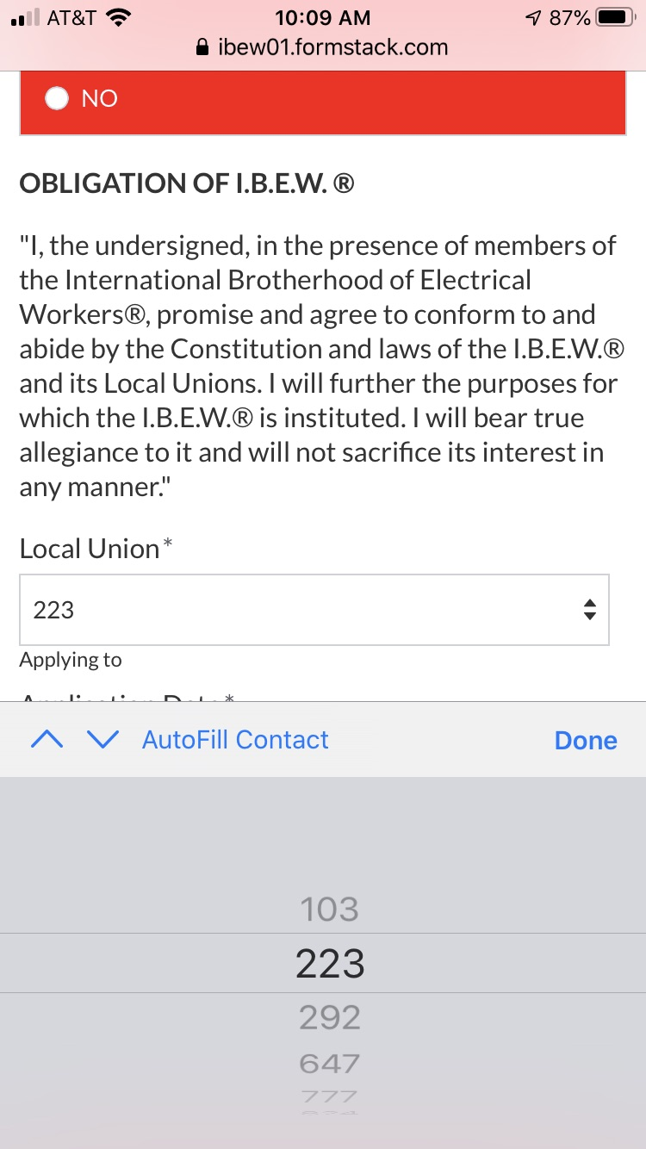
WHY SELECTING A LOCAL IS REQUIRED
A drop-down menu only provides selection of locals that have signed up to use the DMA.
Each local selection has an imbedded email address. (This is how the application is routed to the Local.)
Only USA locals will be listed on USA forms for selection.

Slide 29
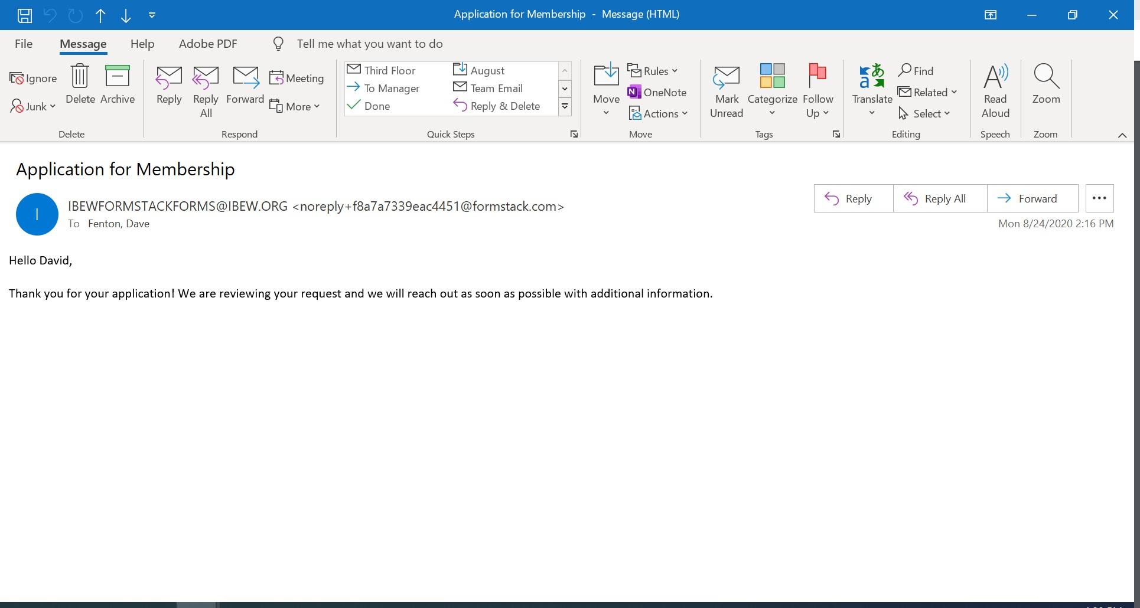
AFTER APPLICANT COMPLETES AN APPLICATION AN EMAIL IS SENT TO APPLICANT NOTIFYING THEM IT IS UNDER REVIEW

Slide 30
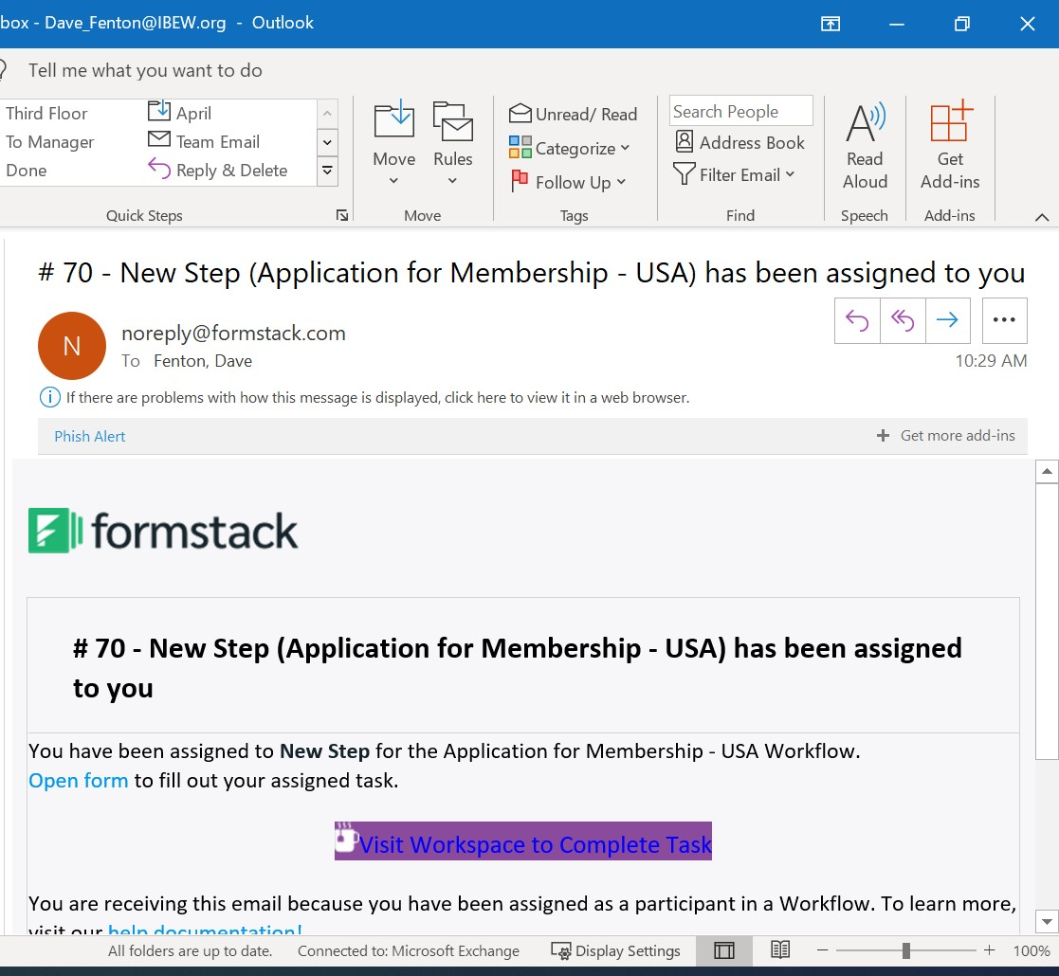
EMAIL TO LOCAL UNION AFTER APPLICATION IS SUBMITTED BY MEMBER
Click here or here to Open App

Slide 31
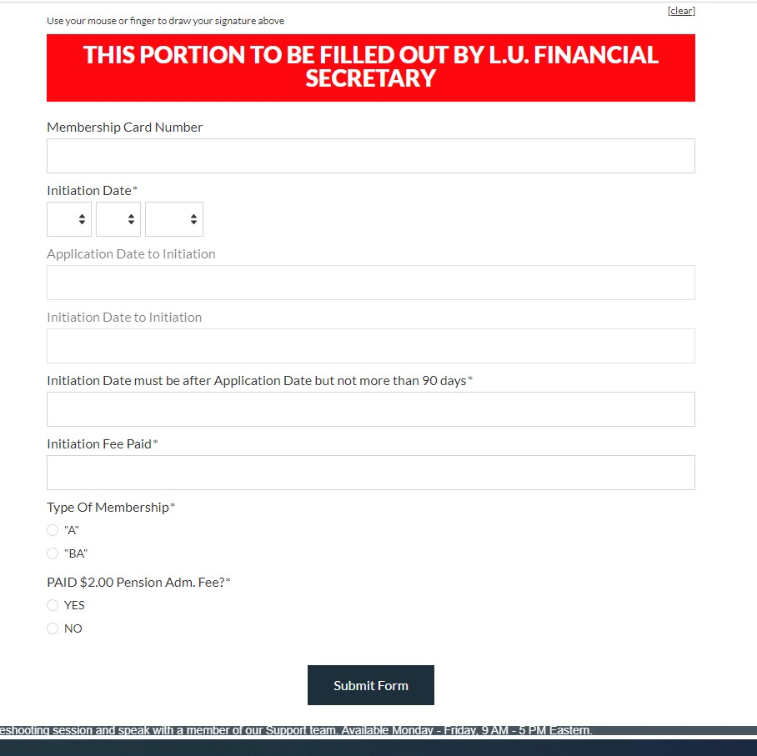
REQUIRED FIELDS THAT MUST BE COMPLETED BY LOCAL UNION
Initiation Date
Membership Type
Initiation Fees (If Applicable)

Slide 32
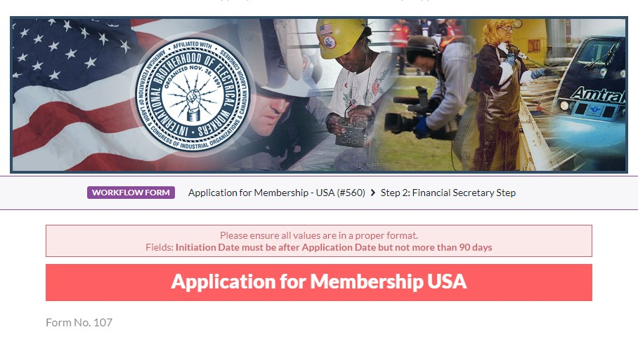
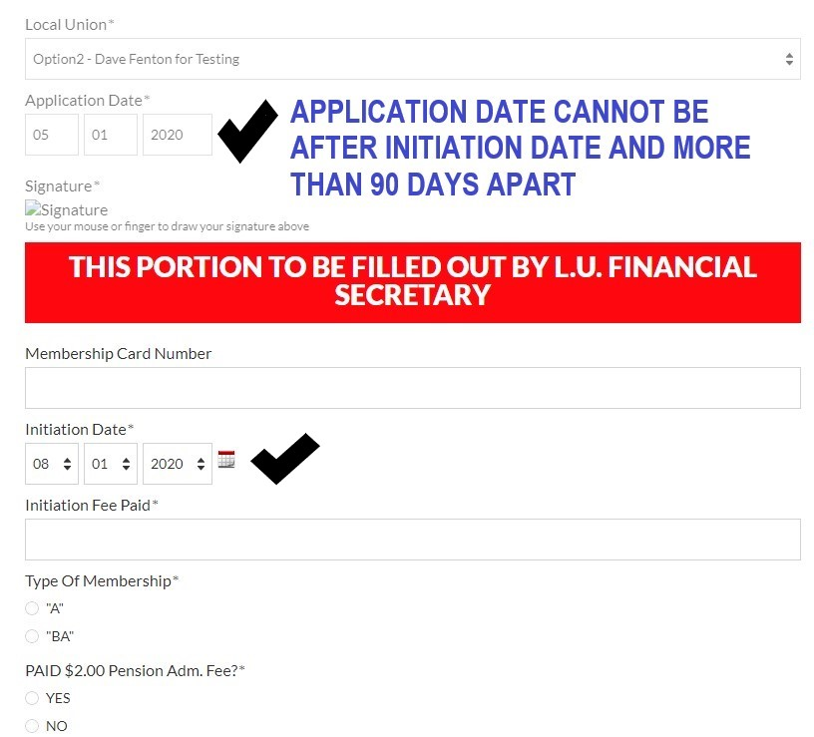
DIGITAL FORM ERROR MESSAGE

Slide 33
WHEN THE LOCAL COMPLETES THEIR PORTION OF THE REQUIRED INFORMATION ON THE APPLICATION THEY WILL SELECT SUBMIT FORM

Slide 34
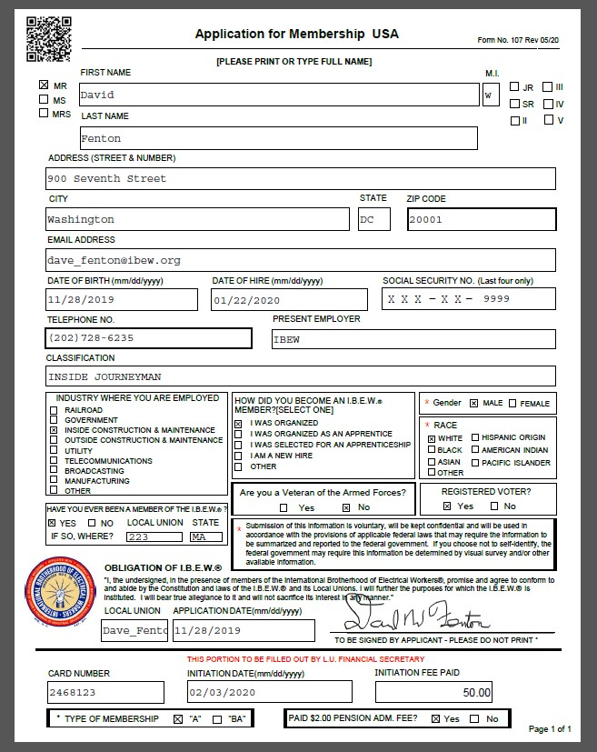
ONCE APPLICATION HAS BEEN COMPLETED AND SUBMITTED BY THE LOCAL.
The Local will receive a completion email with the PDF version auto filled for them to save for local records.
The same PDF application is routed directly to the Local’s digital folder in the per capita department to be processed on their next per capita report to the International Office.

Slide 35
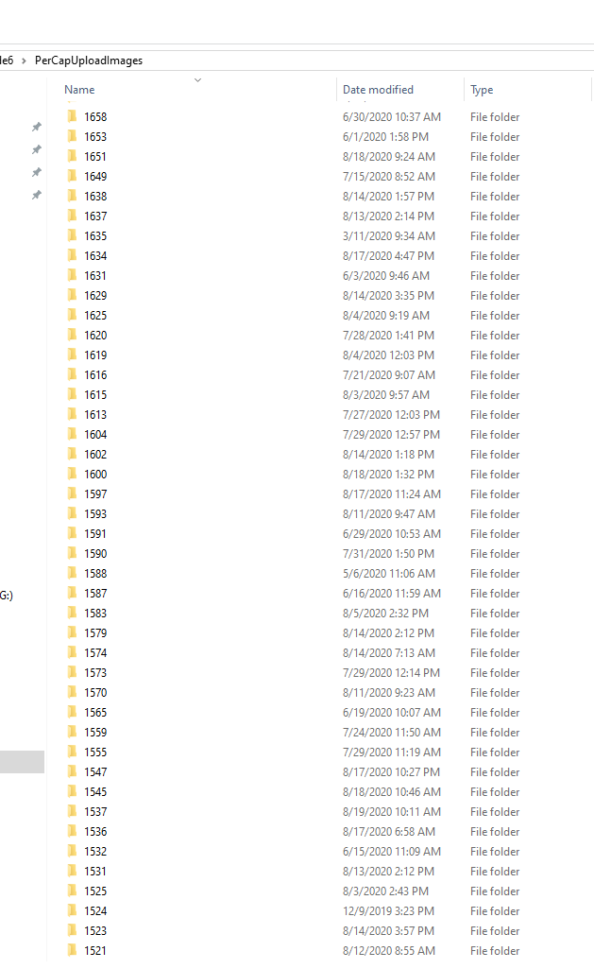
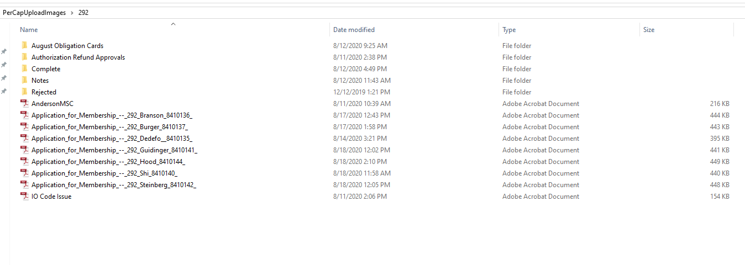
WHEN YOUR LOCAL SUBMITS THE COMLETED FORM WHERE DOES IT GO??
Completed Form gets saved to Local Union’s Folder
Every Local Union has a Digital Folder in the Per Capita Department

Slide 36
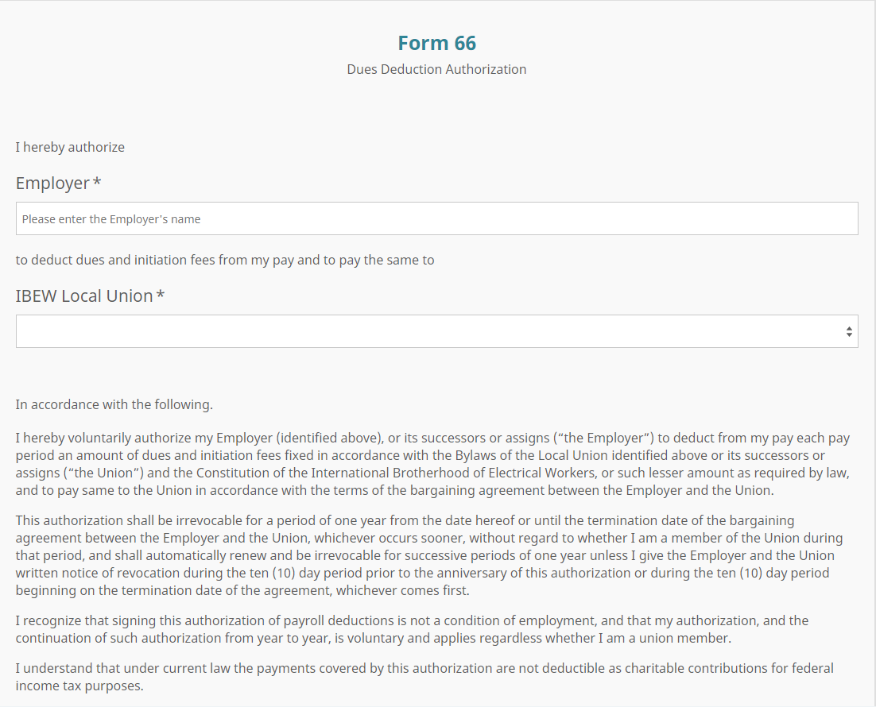
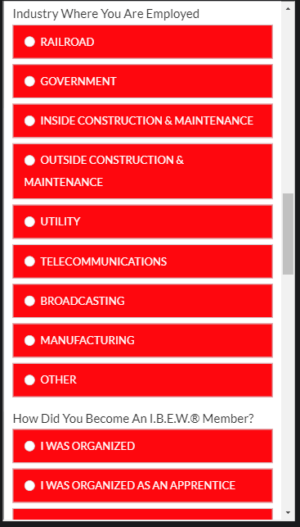
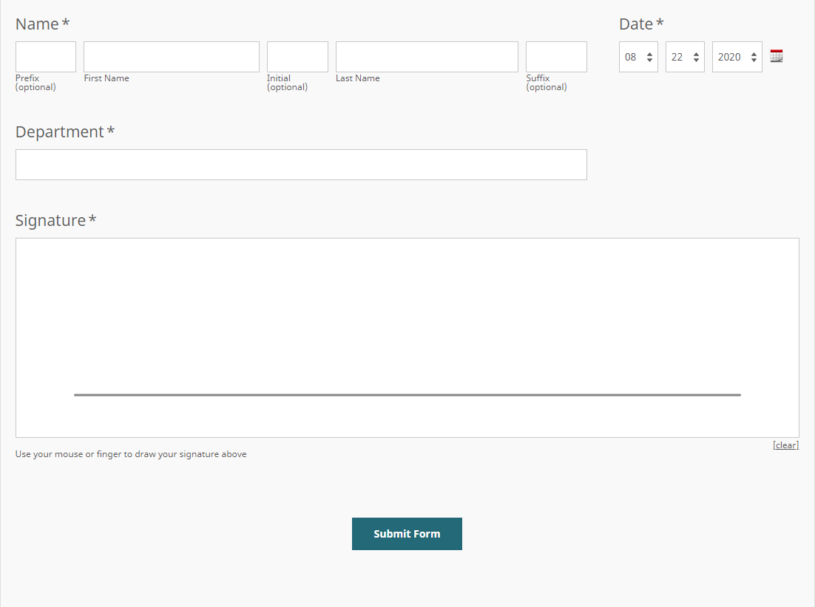
Custom Features For Each Local Union
When USA Local Unions request to use the digital application and is setup for use, the local will have the ability to include the standard updated local dues deduction authorization (Form 66) included to any specific or to all “Industry Where Employed” options on the application platform
This will give the new member the ability to complete the dues deduction authorization form along with the membership application at the same time

Slide 37
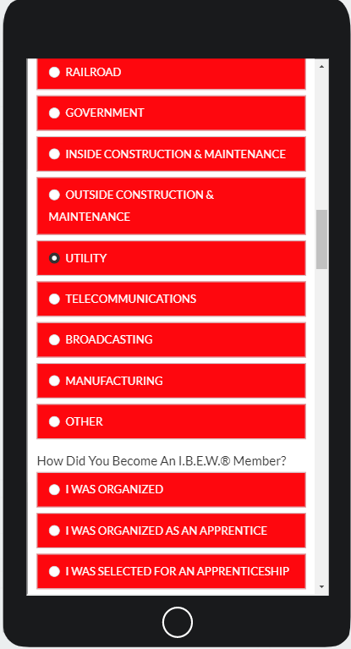
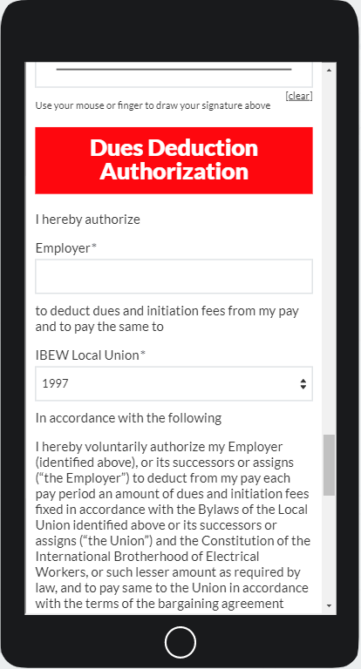
Local Union Dues Deduction Authorization Form 66 Option
When the member selects a specific Industry it will populate the dues deduction authorization form.
The member will have to provide two separate signatures. One for the application to membership and one for dues deduction authorization.

Slide 38
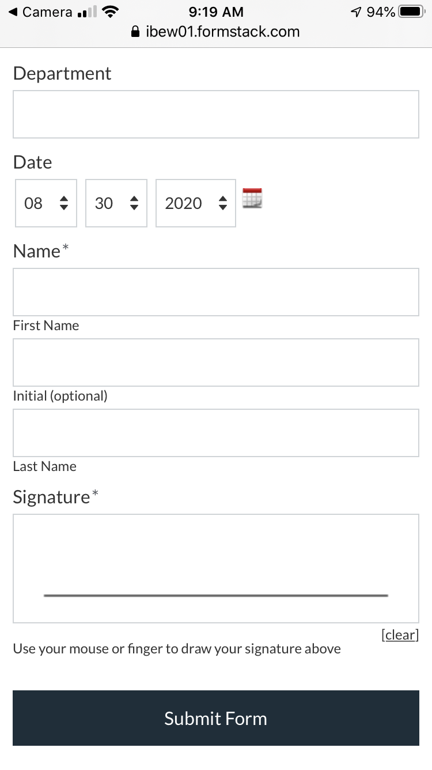
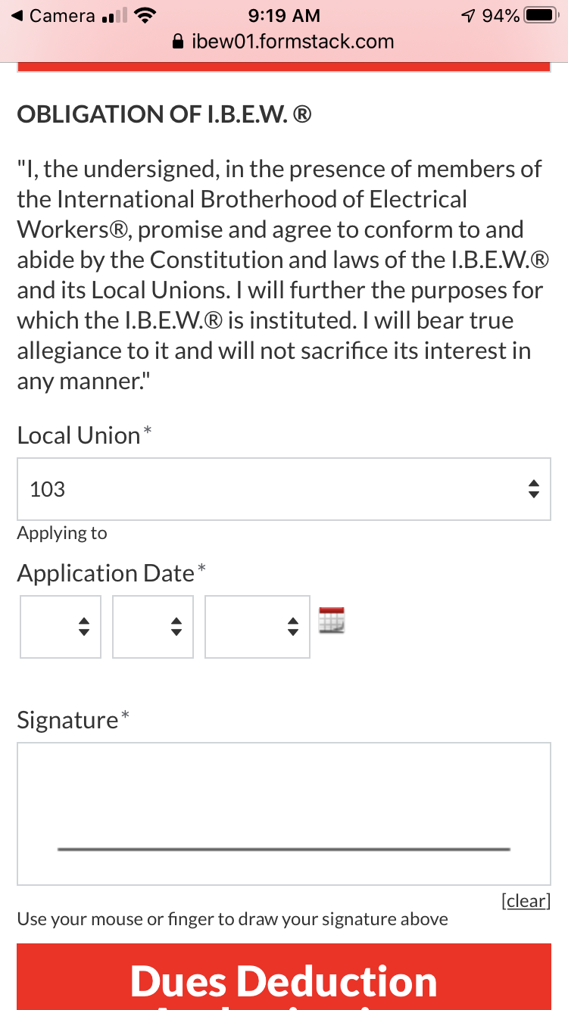
Signature Requirements
- Two signatures are required,
- One for the application
- One for dues deduction

Slide 39
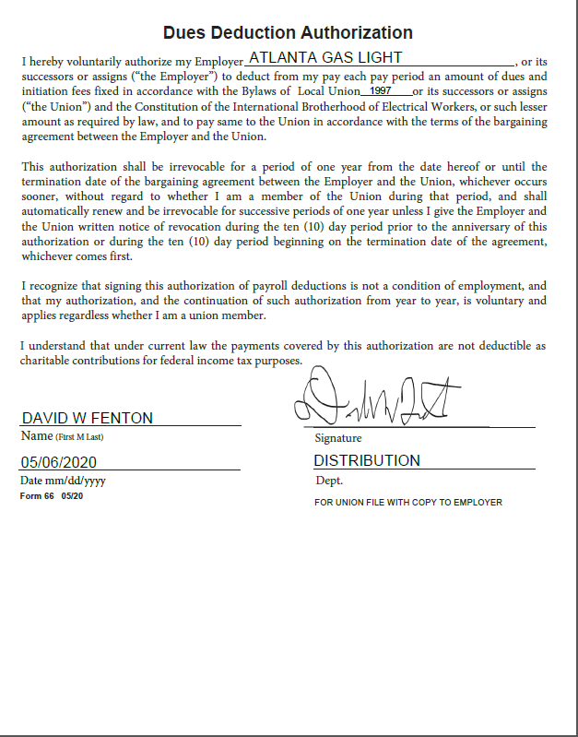
A Separate Email is sent to the Local Union after Dues Deduction Authorization Form 66 is Submitted
When a new member completes a membership application and completes a dues deduction authorization form the local receives two separate emails for each of the forms.
The email with the dues deduction authorization form is for the local’s use to maintain and distribute to the member’s employer. The International Office Does Not receive a copy of this form.

Slide 40
Digital Membership Application Signup:
Contact the Per Capita Department;
- percapita@ibew.org
Per Capita Director
- ibewformstackforms@ibew.org
International Representative
Email: Dave_Fenton@ibew.org
Phone: 202-262-4153
Email: Louis_Spencer@ibew.org
Phone: 202-718-3430
Or
Reach out to your District Office, International Representative or Organizer.

Slide 41
Pension Benefit Fund
Top 5 Issues and
General Information
Benefits of “A” Membership
Access to the Pension Benefit
Access to the Death Benefit

Slide 42
Pension Benefit Eligibility
#1 Issue
- Signatory Employers
  Ownership of business within the electrical industry.
  Holding an active electrical contractors license

Slide 43
#1 Solution
- In the event a Local Union has knowledge of an employer seeking to retire.
- Please request that those members receive written evidence of either the close, sale, or transfer of their business to someone else; preferably someone other than a spouse.
- Receive documentation from a government agency related to their electrical contractors license being no longer open.

Slide 44
#2 Issue
Length of time since last engaged in the electrical industry
Anything outside of 7 years the Pension Department will request a social securities earning report to confirm members aren’t working in the industry.

Slide 45
#2 Solution
Communicate with those members who may have;
- Retired early from your respective pension plans.
- Potentially left the construction trade but are working within a hospital/university/maintenance setting as an electrician.

Slide 46
# 3 Issue
Article XI, Section 6 (d) – Prohibition of work. It is a condition for admission to pension benefits, including vesting pension rights and the continuation thereof, that the member shall not perform any work of any kind coming under the I.B.E.W.’s jurisdiction either for compensation or gratis for anyone, except that a member may work as an instructor in an I.B.E.W. recognized apprenticeship, or as an electrical inspector for a government authority where electrical inspectors are not covered by an approved I.B.E.W. collective bargaining agreement.

Slide 47
# 3 Solution
- Communicate with those members that you may be aware of that are still engaged in the electrical industry. In the event they aren’t working under your collective bargaining agreement, may not necessarily mean they are eligible for a pension benefit.
Again this applies to those working in universities/hospitals and maintenance settings.

Slide 48
#4 Issue
Disability applicants not having an award letter from either the Social Security Administration, Railroad Retirement Board, or similar entity.
- Outdated disability award letter, or letter that does not identify clearly a disability onset date.
- Applying for disability beyond 3 years after being found disabled.

Slide 49
#4 Solution
- Again just communicating with your membership the needs of an award letter from either the Social Security Administration, Railroad Retirement Board, or similar entities. The International Office does retain the services of a medical review officer in certain instances.
Generally speaking it takes sometime to get through the process for Social Security, or Railroad so it’s very important to share the impact of staying current on the members dues payments.

Slide 50
#5 Issue
Completing the Pension application incorrectly

Slide 51
# 5 Solution
Review the pension application prior to submission to the Pension Department. Look for things like;
- Dates
- Email addresses
- Optional Spouse Designation

Slide 52
Pension Application Appeals
If an application is denied by the International Secretary Treasurer, the member has the right to appeal to the International Executive Council, and their appeal will be heard at the next quarterly meeting.

Slide 53
Death Benefit Issues related to Denials
- Active “A” member did not attain 6 months of continual good standing
- Or Active “A” member was not in good standing at the time of death, due to;
- Outstanding assessment “trial board”
- Dues in arrears “reinstatement/dropped”

Slide 54
Death Benefit Issues related to Delays
Did not receive timely notice of members passing
Not provided with the proper forms or documents for processing, such as;
- Death Certificate
- W9 form
- Affidavit of Next of Kin

Slide 55
Pension Benefit Fund History
- Electrical Workers Benefit Association (EWBA) established in 1922
- 1928 – Pension benefit authorized at the 1927 Convention; for “A” Members only.
- 1928 – 1965 – Normal Only Benefit (age 65 or older)
- 1966 – Disability and Vested Pensions options added
- 1970 – Optional Spousal Benefit added
- 1973 – Early Retirement Benefit added
- 1992 – January 1, 1992 – EWBA & PBF merged

Slide 56
Pension Benefit Fund Facts
- Currently 118,381 retirees and spouses receive a monthly PBF benefit.
- 6,958 members retired during FY 2020.
- Annual pension payments for FY 2020 – over $152 Million
- PBF paid 6,472 death claims in FY 2020 – over $14.5 Million

Slide 57
Article XI – Admission to Pension
- PBF is a union-dues financed plan with no employer contributions whatsoever. Thus, PBF is not subject to vesting requirements of ERISA
- Current contribution rate is $19.00 per month
- “A” members must maintain continuous good standing until the member is placed on pension
- Retired members may not work in the Electrical Industry, expect as permitted in Article XI, Section 6: - (a) Instructor for an I.B.E.W. recognized apprenticeship program. (b) an electrical inspector for a government authority where inspectors are not covered by an approved I.B.E.W. collective bargaining agreement.
- The IEC interprets “Electrical Industry” very broadly

Slide 58
Pension Application Procedures
- Make application no more than six (6) months before retirement.
- Applications available online at Local Union Connections and www.ibew.org/links
- Member must complete entire application, including direct deposit form, or application will not be processed
- Local Union must approve application and provide signatures including Local Union seal before sending application and required documents to the IBEW Pension and Reciprocity Department

Slide 59
Normal Pension Benefit
- Must be age 65 and have a minimum 5 years service.
- Monthly benefit based on $4.50 x years of continuous membership effective January 1, 2007.
- May not work in the electrical industry, expect as permitted in Article XI, Section 6 (d)
- Optional Spousal Benefit is available but is irrevocable once placed on pension.
- Lump sum payment if monthly benefit is equal or less than $30.00 (U.S.) or Canadian equivalent
EXAMPLE:
Cost: 10 years x $19.00/month x 12 months = $2,280 total paid.
Benefit: 10 years x $4.50/year x 12 months = $540 per year.
Return: $2,280 ÷ $540 = 4.22 years to recover all PBF dues paid over 10 years.

Slide 60
Early Pension Benefit
- Age 62 – 64 with a minimum of 20 years of service
- Monthly benefit based on $4.50 x years of continuous membership effective January 1, 2007, reduced by 6.66% for each year under age 65
- May not work in the electrical industry, expect as permitted in Article XI, Section 6 (d)
- Optional Spousal Benefit is available and irrevocable once placed on pension
- Early retirement, once selected, is irrevocable
- Lump sum payment if monthly benefit equal or less than $30.00 (U.S.) or equivalent
EXAMPLE - at age 62
Cost: 30 years x $19.00/month x 12 months = $6,840
Benefit: 30 years x $4.50/year x 12 months = $1620 x 19.98% = 323.67 Annually: $1620 – 323.67 = $1296.33
Return: $6,840 ÷ $1296.33 = 5.27 years to recover all PBF dues paid over 30 years.

Slide 61
Disability Pension Benefit
- Must have a minimum of 20 years of service
- Monthly benefit based on $4.50 x years of continuous membership effective January 1, 2007
- Must be totally disabled; may not work whatsoever (unlike Social Security)
- SSD or CPP award or equivalent is preferred. In lieu of award, medical information may be submitted and reviewed by IBEW physician
- Optional Spousal Benefit available and is irrevocable once placed on pension
- Suggest making application if member has filed for SSD, PPD, or equivalent
EXAMPLE
Cost: 20 years x $19.00/month x 12 months = $4,560.00
Benefit: 20 years x $4.50/year x 12 months = $1,080.00
Return: $4,560 ÷ $1,080 = 4.22 years to recover all PBF dues paid over 20 years

Slide 62
Vested Pension Benefit
- Must have a minimum of 20 years service
- PBF does not have automatic vesting – if you are eligible and wish to leave “A” membership – you must apply or lose pension benefits
- Will not qualify unless leaving the electrical industry
- Pay-out rate of $4.50 per year of continuous service reduced by $4.50 for each year member is under age 65 at time of application
- Vested pension available first month following 65th birthday. Retiree must contact PBF
- No Disability Pension, Death Benefit or Optional Spousal Benefit
- Lump sum payment made if monthly benefit equal to or less than $30.00 (U.S.) or Canadian equivalent
- Instead of vested pension, I.O. encourages members leaving the electrical industry to take a Participating Withdrawal – contact the Local Union Financial Secretary
EXAMPLE at age 42
Cost: 20 years x $19.00/month x 12 months = $4,560
Benefit: 20 years x $4.50/year x 12 months; reduced by 4.50 for each year prior to age 65 = $0
Return: 0 – suggest going the route of Participating Withdrawal

Slide 63
Optional Spousal Benefit
- Normal, early and disability applicants can elect the OSB
- Election cannot be changed once member is placed on pension
- OSB reduces monthly benefit to 86.5% plus or minus .5%, based on calculation using members and spouses birth dates
- Upon member’s death spouse receives one half of the members monthly benefit
- Lump sum payments made if monthly benefit equal or less than $30.00 (U.S.) or Canadian equivalent
- Members pension will “pop-up” if spouse predeceases or divorces member

Slide 64
Death Benefits
- Average age of death: 81.2
- Normal DB = $6,250.00
- Accidental DB only for active “A” members = $12,500.00
- Retiree DB is reduced from $6,250 by amount of pension payments received, but no lower than $3,000
- Member must have minimum six months continuous good standing to be eligible for DB
- Per Art. XI, member who is more than 2 months in arrears is ineligible, unless arrearage was no fault of the member
- Only active “A” members and Normal, Early, and Disability pensioners are eligible for DB. Vested pensioners are ineligible
- Per Art. XI, Section 4 (b), all members have the right to name a beneficiary
- In the absence of a named beneficiary DB will be paid in descending order: members spouse, children, parents, estate
- Contact PBF to initiate a claim

Slide 65
Questions??
Director:
Ryan O’Leary
Ryan_Oleary@ibew.org
202-728-6206
Pension@ibew.org
Reciprocity@ibew.org

